Slide 1
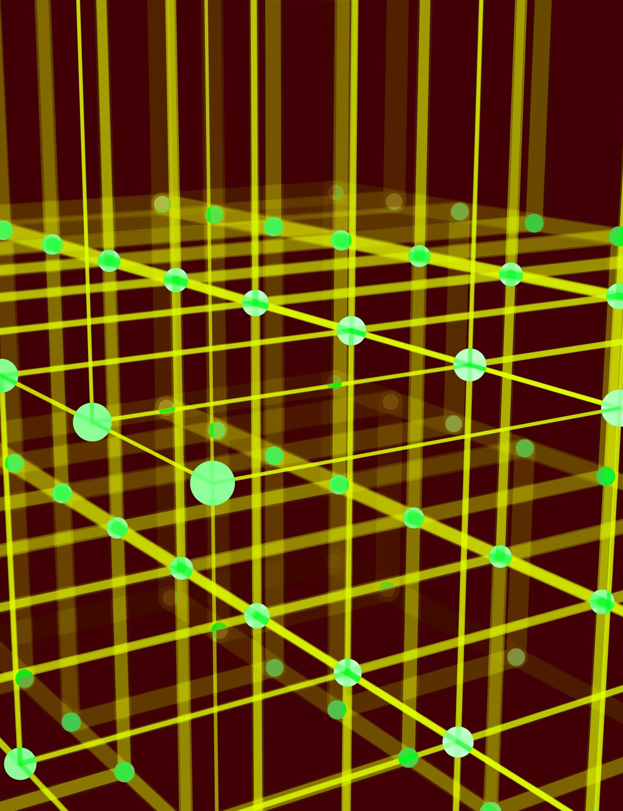
Greedy Algorithms
Yongcai Wang
Renmin University of China

Slide 2
适合用贪心算法求解的问题特点
贪心选择性质（Greedy Choice Property）：在每一步选择中，都能够选择一个局部最优解，而这个选择不会对剩余的问题产生负面影响。
最优子结构性质（Optimal Substructure Property）：通过解决子问题的最优解，可以构建出原问题的最优解。
OPT(P)=Greedy(S₁)+OPT(P/S₁)
Greedy(S₁)
OPT(P/S₁)
本质上是无后效性
当前看起来最好的选择
剩余的子问题

Slide 3
回顾上节课内容 （1）
活动选择问题
a₅
a₁
a₃
a₇
a₄
a₂
a₆
time
t₁
t₂
t₂
C[0, T] = 1 + C[t₁, T] = 1+ C[t₂, T] = 1+ C[t₃, T]
最优活动选择的集合并不是唯一的，与选择活动冲突的活动是等价的。
最优策略也不是唯一的，以最晚开始时间优先，也能得到最优解。
贪心策略本质是：选择一个活动后，为剩余子问题留出尽可能多的活动时间

Slide 4

主要内容
Huffman Coding
Algorithm and proof of optimality
Greedy Algorithms on Graphs
Optimal Greedy Algorithms on Graphs
Efficient Greedy Algorithms on Graphs
Dynamic Programming
Optimal Substructure
Weighted Interval Scheduling
Longest Common Subsequence

Slide 5
One more example Huffman coding
everyday english sentence
01100101 01110110 01100101 01110010 01111001 01100100 01100001 01111001 00100000 01100101 01101110 01100111 01101100 01101001 01110011 01101000 00100000 01110011 01100101 01101110 01110100 01100101 01101110 01100011 01100101
qwertyui_opasdfg+hjklzxcv
01110001 01110111 01100101 01110010 01110100 01111001 01110101 01101001 01011111 01101111 01110000 01100001 01110011 01100100 01100110 01100111 00101011 01101000 01101010 01101011 01101100 01111010 01111000 01100011 01110110
英文单词的ASCII码

Slide 6
One more example Huffman coding
ASCII is pretty wasteful for English sentences. If e shows up so often, we should have a shorter way of representing it!
everyday english sentence
01100101 01110110 01100101 01110010 01111001 01100100 01100001 01111001 00100000 01100101 01101110 01100111 01101100 01101001 01110011 01101000 00100000 01110011 01100101 01101110 01110100 01100101 01101110 01100011 01100101
qwertyui_opasdfg+hjklzxcv
01110001 01110111 01100101 01110010 01110100 01111001 01110101 01101001 01011111 01101111 01110000 01100001 01110011 01100100 01100110 01100111 00101011 01101000 01101010 01101011 01101100 01111010 01111000 01100011 01110110
在消息发送时，这样编码是浪费字符数的。

Slide 7
Suppose we have some distribution on characters

Slide 8
Suppose we have some distribution on characters
For simplicity, let’s go with this made-up example
How to encode them as efficiently as possible?
45
Percentage
A
16
D
13
B
12
9
C
E
5
F
Letter

Slide 9
Try 0 (like ASCII)
Every letter is assigned a binary string of three bits.
Wasteful!
110 and 111 are never used.
We should have a shorter way of representing A.
45
Percentage
A
16
D
13
B
12
9
C
E
5
F
000
001
010
011
100
101
Letter

Slide 10
Try 1
Every letter is assigned a binary string of one or two bits.
The more frequent letters get the shorter strings.
Problem:
Does 000 mean AAA or BA or AB?
45
Percentage
A
16
D
13
B
12
9
C
E
5
F
00
01
1
10
11
Letter
0

Slide 11
Try 2: prefix-free coding
Confusingly, “prefix-free codes” are also sometimes called “prefix codes” (e.g. in CLRS).
Every letter is assigned a binary string.
More frequent letters get shorter strings.
No encoded string is a prefix of any other.
45
Percentage
A
10010101
16
D
13
B
12
9
C
E
5
F
101
110
00
111
100
Letter
01

Slide 12
Try 2: prefix-free coding
Confusingly, “prefix-free codes” are also sometimes called “prefix codes” (including in CLRS).
Every letter is assigned a binary string.
More frequent letters get shorter strings.
No encoded string is a prefix of any other.
45
Percentage
F
A
10010101
16
D
13
B
12
9
C
E
5
F
101
110
00
111
100
Letter
01

Slide 13
Try 2: prefix-free coding
Confusingly, “prefix-free codes” are also sometimes called “prefix codes” (including in CLRS).
Every letter is assigned a binary string.
More frequent letters get shorter strings.
No encoded string is a prefix of any other.
45
Percentage
FB
A
10010101
16
D
13
B
12
9
C
E
5
F
101
110
00
111
100
Letter
01

Slide 14
Try 2: prefix-free coding
Confusingly, “prefix-free codes” are also sometimes called “prefix codes” (including in CLRS).
Every letter is assigned a binary string.
More frequent letters get shorter strings.
No encoded string is a prefix of any other.
45
Percentage
FBA
A
10010101
Question: What is the most efficient way to do prefix-free coding?
That is, how can we use as few bits as possible in expectation?
16
D
13
B
12
(This is not it).
9
C
E
5
F
101
110
00
111
100
Letter
01

Slide 15
A prefix-free code is a tree
B:13 below means that ‘B’ makes up 13% of the characters that ever appear.
0
1
0
1
1
0
A: 45
D: 16
00
01
0
1
0
1
F:5
B:13
C:12
E:9
As long as all the letters show up as leaves, this code is prefix-free.
100
101
110
111

Slide 16
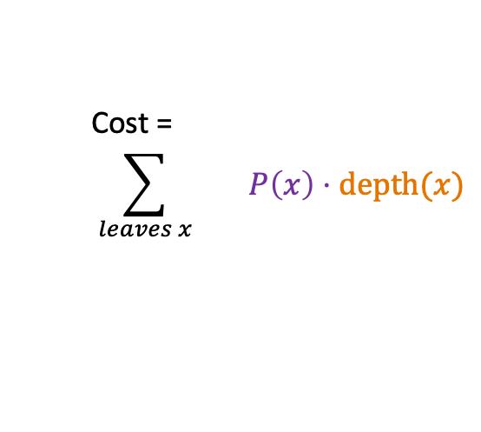
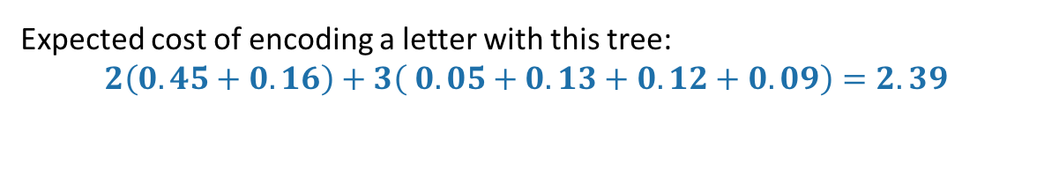
How good is a tree?
Imagine choosing a letter at random from the language.
Not uniformly random, but according to our histogram!
The cost of a tree is the expected length of the encoding of a random letter.
The depth in the tree is the length of the encoding
Cost =
$$\sum_{leaves x}{ P\left(x\right)⋅\text{depth}(x)}$$
0
1
P(x) is the probability of letter x
0
1
1
0
A: 45
D: 16
00
01
0
1
0
1
F:5
B:13
C:12
E:9
100
101
110
111
Expected cost of encoding a letter with this tree:
$$2\left(0.45+0.16\right)+3\left( 0.05+0.13+0.12+0.09\right)=2.39$$

Slide 17
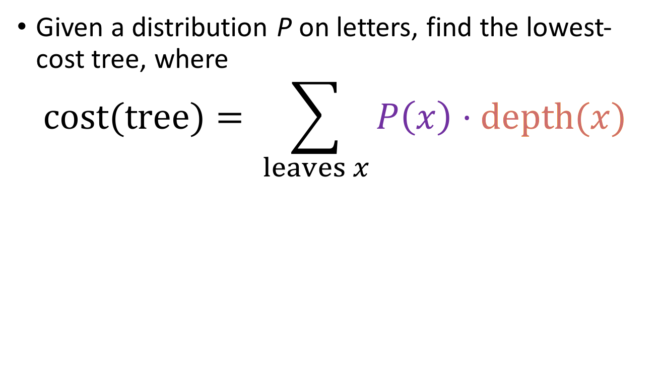
Question
Given a distribution P on letters, find the lowest-cost tree, where
$$cost(tree)= \sum_{leaves x}{P\left(x\right)⋅\text{depth}(x)}$$
P(x) is the probability of letter x
The depth in the tree is the length of the encoding

Slide 18
Greedy algorithm
Greedily build sub-trees from the bottom up.
Greedy goal: less frequent letters should be further down the tree.

Slide 19
Solution greedily build subtrees, starting with the infrequent letters
14
0
1
A: 45
B:13
C:12
D: 16
E:9
F:5

Slide 20
Solution greedily build subtrees, starting with the infrequent letters
25
14
0
1
0
1
A: 45
B:13
C:12
D: 16
E:9
F:5

Slide 21
Solution greedily build subtrees, starting with the infrequent letters
30
1
25
14
0
0
1
0
1
A: 45
B:13
C:12
D: 16
E:9
F:5

Slide 22
Solution greedily build subtrees, starting with the infrequent letters
55
1
30
0
1
25
14
0
0
1
0
1
A: 45
B:13
C:12
D: 16
E:9
F:5

Slide 23
Solution greedily build subtrees, starting with the infrequent letters
100
1
55
1
30
0
0
1
25
14
0
0
1
0
1
A: 45
B:13
C:12
D: 16
E:9
F:5

Slide 24
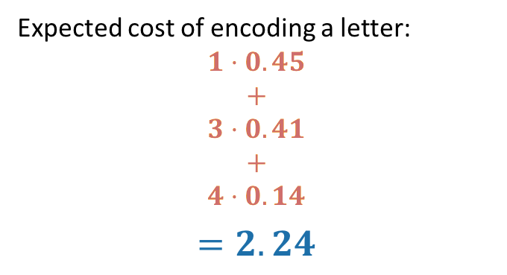
Solution greedily build subtrees, starting with the infrequent letters
100
Expected cost of encoding a letter:
$$1⋅0.45$$
$$+$$
$$3⋅0.41$$
$$+$$
$$4⋅0.14$$
$$=2.24$$
0
1
55
A: 45
0
1
0
30
25
0
0
1
1
C:12
D: 16
14
B:13
101
110
0
1
100
E:9
F:5
1110
1111

Slide 25
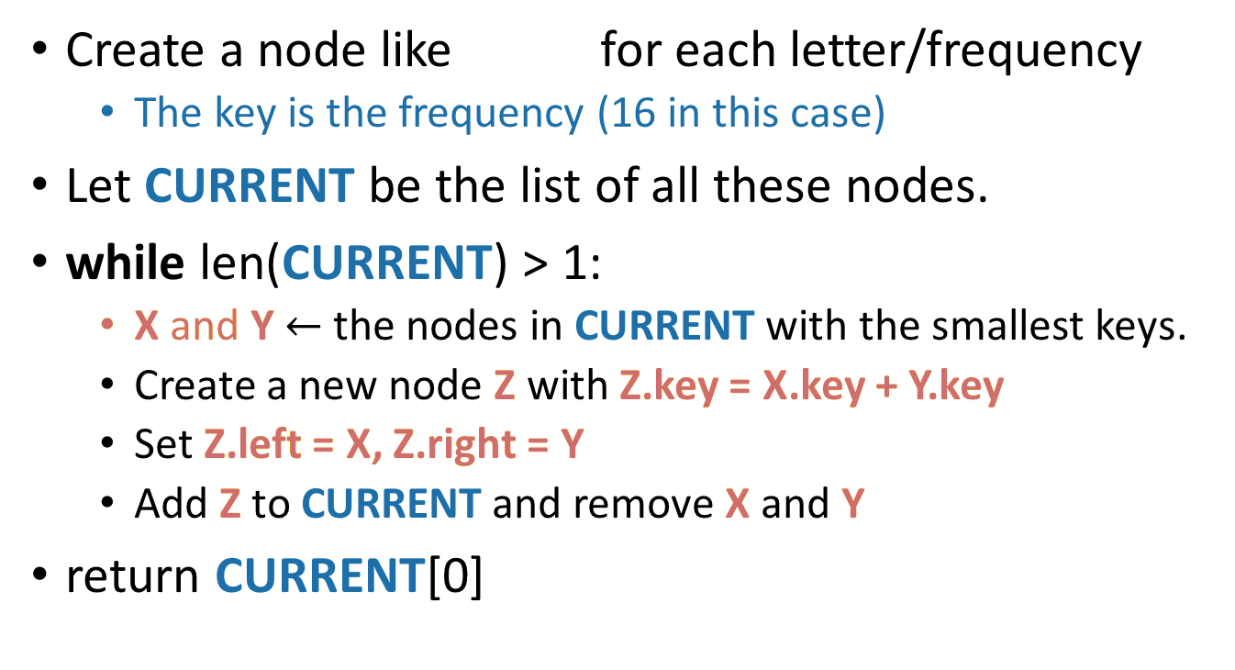
What exactly was the algorithm?
D: 16
Create a node like for each letter/frequency
The key is the frequency (16 in this case)
Let CURRENT be the list of all these nodes.
while len(CURRENT) > 1:
X and Y $←$ the nodes in CURRENT with the smallest keys.
Create a new node Z with Z.key = X.key + Y.key
Set Z.left = X, Z.right = Y
Add Z to CURRENT and remove X and Y
return CURRENT[0]
14
Z
0
1
A: 45
B:13
C:12
D: 16
F:5
E:9
X
Y

Slide 26
This is called Huffman Coding:
D: 16
Create a node like for each letter/frequency
The key is the frequency (16 in this case)
Let CURRENT be the list of all these nodes.
while len(CURRENT) > 1:
X and Y $←$ the nodes in CURRENT with the smallest keys.
Create a new node Z with Z.key = X.key + Y.key
Set Z.left = X, Z.right = Y
Add Z to CURRENT and remove X and Y
return CURRENT[0]
14
Z
0
1
A: 45
B:13
C:12
D: 16
F:5
E:9
X
Y

Slide 27
Does it work?
Yes.
We will sketch a proof here.
Same strategy:
Show that at each step, the choices we are making won’t rule out an optimal solution.
Lemma:
Suppose that x and y are the two least-frequent letters. Then there is an optimal tree where x and y are siblings.
14
0
1
A: 45
B:13
C:12
D: 16
E:9
F:5

Slide 28
Lemma proof idea
If x and y are the two least-frequent letters, there is an optimal tree where x and y are siblings.
Say that an optimal tree looks like this:
What happens to the cost if we swap x for a?
the cost can’t increase; a was more frequent than x, and we just made a’s encoding shorter and x’s longer.
Repeat this logic until we get an optimal tree with x and y as siblings.
The cost never increased so this tree is still optimal.
x
Lowest-level sibling nodes: at least one of them is neither x nor y
a

Slide 29
Lemma proof idea
If x and y are the two least-frequent letters, there is an optimal tree where x and y are siblings.
Say that an optimal tree looks like this:
What happens to the cost if we swap x for a?
the cost can’t increase; a was more frequent than x, and we just made a’s encoding shorter and x’s longer.
Repeat this logic until we get an optimal tree with x and y as siblings.
The cost never increased so this tree is still optimal.
Lowest-level sibling nodes: at least one of them is neither x nor y
x
y

Slide 30
Huffman Coding Works (idea)
Show that at each step, the choices we are making won’t rule out an optimal solution.
Lemma:
Suppose that x and y are the two least-frequent letters. Then there is an optimal tree where x and y are siblings.
That’s enough to show that we don’t rule out optimality on the first step.
14
0
1
A: 45
B:13
C:12
D: 16
E:9
F:5

Slide 31
Huffman Coding Works (idea)
Show that at each step, the choices we are making won’t rule out an optimal solution.
Lemma:
Suppose that x and y are the two least-frequent letters. Then there is an optimal tree where x and y are siblings.
That’s enough to show that we don’t rule out optimality on the first step.
To show that continue to not rule out optimality once we start grouping stuff…
30
1
25
14
0
0
0
1
1
A: 45
B:13
C:12
D: 16
E:9
F:5

Slide 32
Huffman Coding Works (idea)
To show that continue to not rule out optimality once we start grouping stuff…
The basic idea is that we can treat the “groups” as leaves in a new alphabet.
30
1
25
14
0
0
0
1
1
A: 45
B:13
C:12
D: 16
E:9
F:5

Slide 33
Huffman Coding Works (idea)
To show that continue to not rule out optimality once we start grouping stuff…
The basic idea is that we can treat the “groups” as leaves in a new alphabet.
Then we can use the lemma from before.
30
1
DEF:30
25
14
BC:25
0
0
0
1
1
A: 45
B:13
C:12
D: 16
E:9
F:5

Slide 34
Recap I
Greedy algorithms!
Five examples:
Substructure
Matroid
Activity Selection/Interval Scheduling
Interval Partitioning
Maximum Lateness Minimization Scheduling
Sum Penalty Minimization Scheduling
Huffman Coding

Slide 35
Recap II
Greedy algorithms!
Often easy to write down
But may be hard to come up with and hard to justify
The natural greedy algorithm may not always be correct.
A problem is a good candidate for a greedy algorithm if:
it has optimal substructure
that optimal substructure is REALLY NICE
solutions depend on just one other sub-problem.

Slide 36
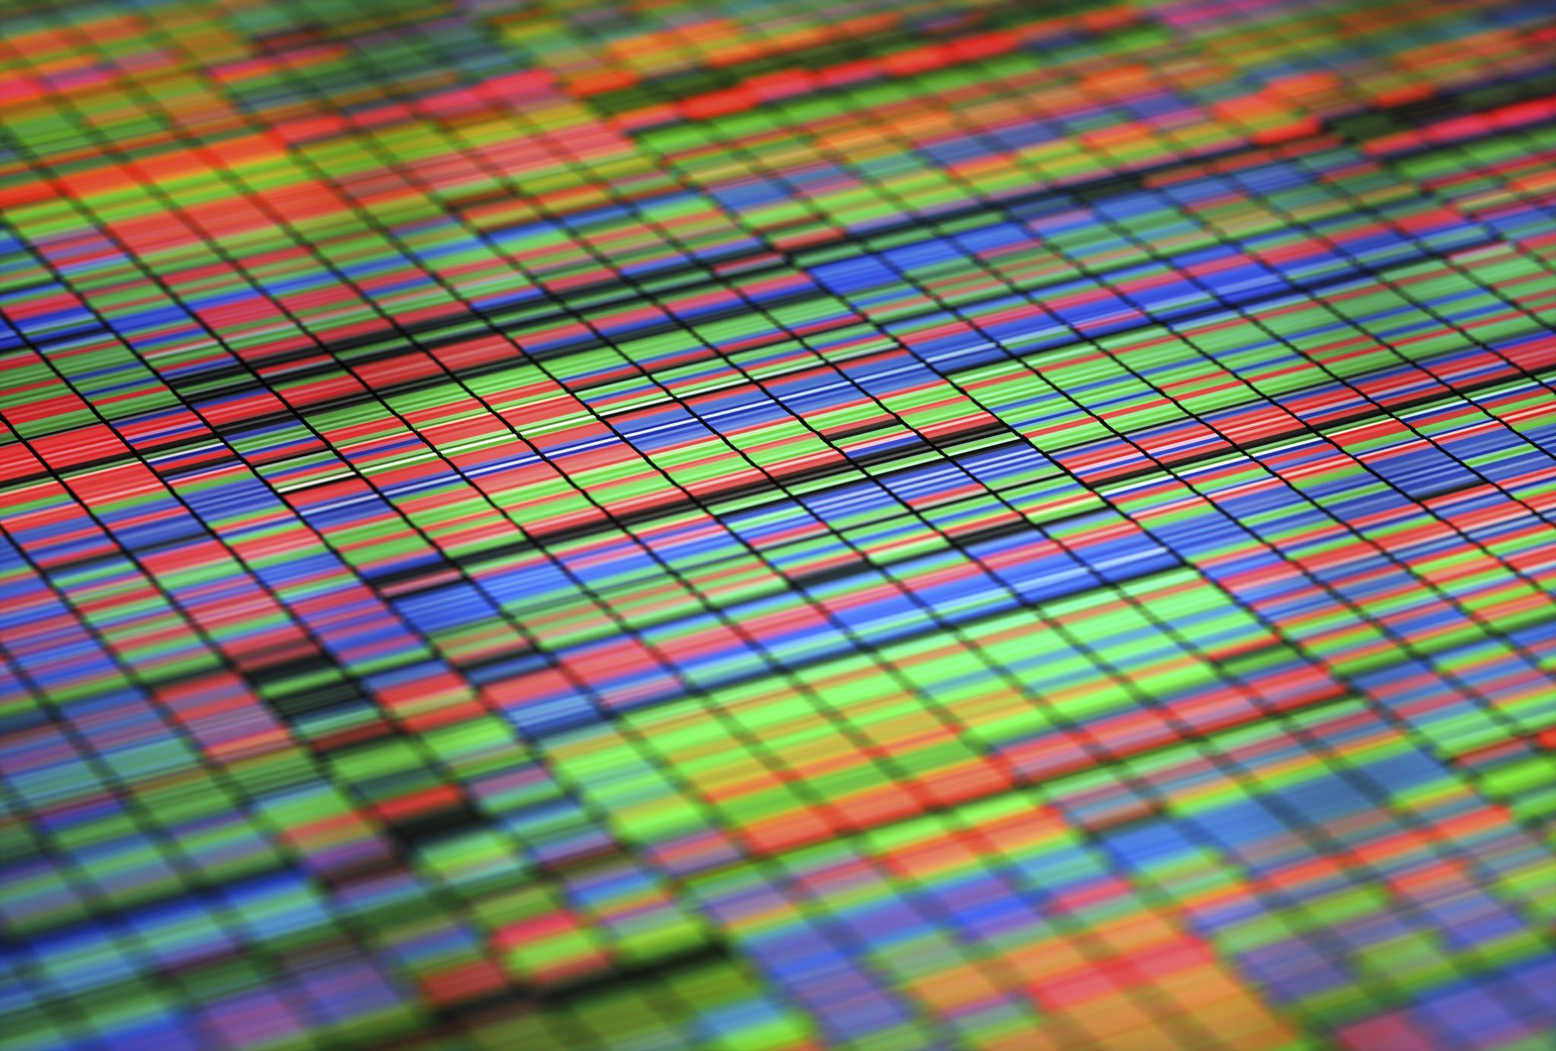
Greedy Algorithm on Graphs

Slide 37
Optimal Greedy Algorithms on Graph
Dijkstra’s algorithm for finding the shortest path in a graph
Always takes the shortest edge connecting a known node to an unknown node
Kruskal’s algorithm for finding a minimum-cost spanning tree
Always tries the lowest-cost remaining edge
Prim’s algorithm for finding a minimum-cost spanning tree
Always takes the lowest-cost edge between nodes in the spanning tree and nodes not yet in the spanning tree

Slide 38
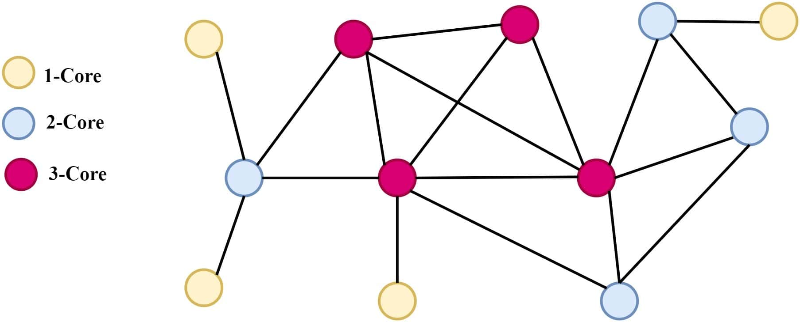
Optimal Greedy Algorithms on Graph - k-core and Peeling Algorithm
In graph theory, the K-Core of a graph is a maximal subgraph in which every vertex has at least degree K.
K-Cores are used to identify the most tightly connected parts of a graph and can provide insights into the overall structure and behavior of a network.

Slide 39
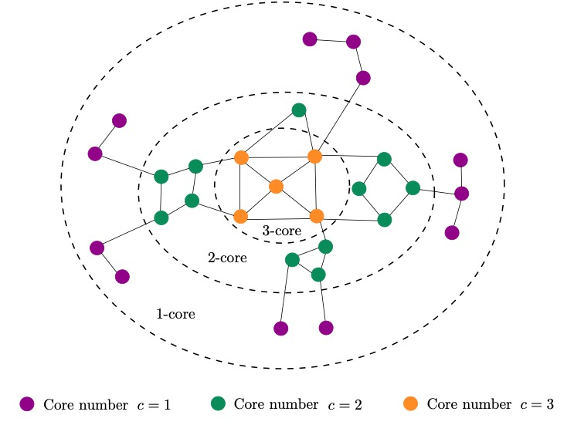
k-core and Peeling Algorithm

Slide 40
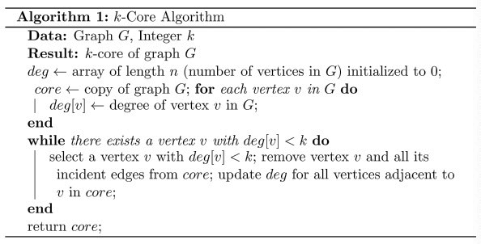
k-core and Peeling Algorithm
We first initialized an array of degrees for each vertex and a copy of the original graph.
We then iteratively remove vertices with degrees less than k and update the degrees of adjacent vertices until no such vertices remain
Time complexity O(n+m).

Slide 41
k-core and Peeling Algorithm
1
2
3
4
4
4
5
2
1
3
3 4
1 2 6
2 5 6 7
4 6 7 8
3 4 5 7
4 5 6 8 9
5 7
7
2
2
4
4
4
4
2
0
2
1
3
4
5
6
7
8
9

Slide 42
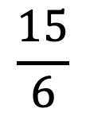
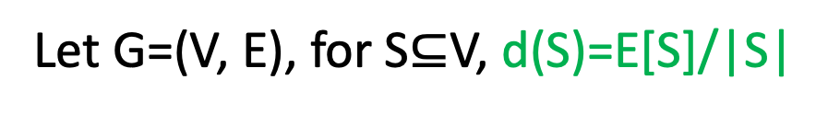
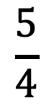
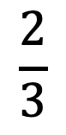
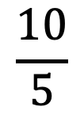
The efficient but not optimal ones
搜索大图中的最密子图问题（DSP）：
Let G=(V, E), for S$⊆$V, d(S)=E[S]/|S|
子图的密度等于子图中的边数除以子图顶点数，求G中的最密子图
$$\frac{2}{3}$$
$$\frac{15}{6}$$
$$\frac{10}{5}$$
$$\frac{5}{4}$$

Slide 43
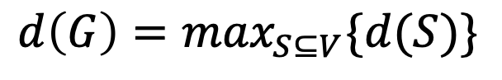
最密子图定义
对于无向图G(V, E)，最密子图的密度定义为：
$$d\left(G\right)=\max_{S⊆V}\{d(S)\}$$
所有子图中密度最大的子图的密度
d(S)=E[S]/|S|
2d(S) 是什么？
2d(G) 是什么？
S中节点度的平均值
最稠密模块节点度的平均值
DSP问题可以用最大流算法精确求解，时间复杂度为O(lognm²)，我们后面课程中再讲。
[1] E. L. Lawler. Combinatorial Optimization: Networks and Matroids. Holt, Rinehart and Winston (1976).

Slide 44
贪心的Peeling（剥洋葱）算法
精确算法复杂度，O(logn m²) 在大图上太高了。
寻求高效率的DSP算法。
M. Charikar, “Greedy Approximation Algorithms for Finding Dense Components in a Graph,” in Approximation Algorithms for Combinatorial Optimization,, 2000, pp. 84–95.
最后一步是在所有n个子图中找密度最大的。

Slide 45
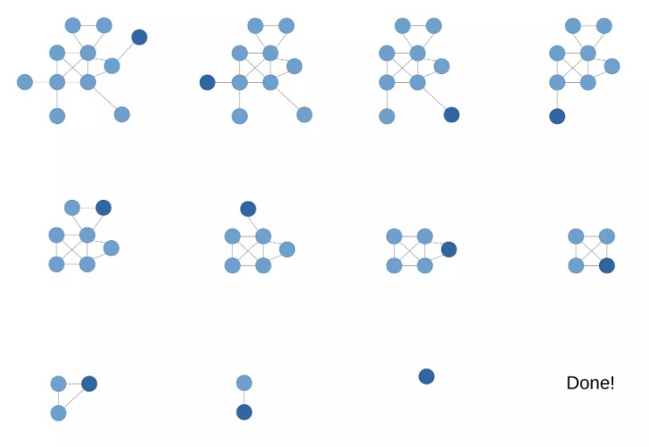
算法举例

Slide 46
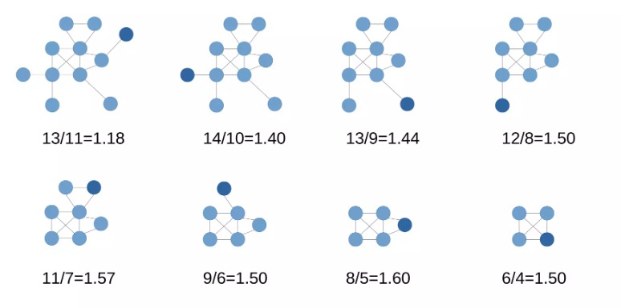
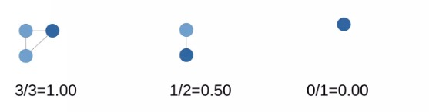
算法举例
d(S)=E[S]/|S|

Slide 47
算法优化
Naive implementation runs in O(n²) time.
删除n轮，每轮O(n)的时间去找最小度的节点。花费O(n²)时间。
最后花费O(n)的时间计算n个子图的密度，和找出最密子图。
整体上O(n²)
利用“degree-lists” 结构来加速: O(n+m)
所有具有相同度数的顶点被放置在同一个list中，并且list按照度数增加的顺序排列。
n次删除，每次删除后需要把邻居节点挪到前面一个list，时间成本N[v]。
所以总的时间成本是O(n+m)

Slide 48
算法优化
用二进制堆结构来存储 “degree-lists”
用最小堆结构，树上每个节点的degree大于等于其父节点。
所以每次peeling要删除的是根节点。
每次删除之后，需要花费O(log n)的时间维护最小堆结构。
所以总时间复杂度是O(n logn)

Slide 49
总结
霍夫曼编码
图上最优的贪心算法
Dijkstra’s Algorithm
Kruskal’s Algorithm
Prim’s Algorithm
K-Core Peeling Algorithm
图上近似的贪心算法举例
Peeling Algorithm for DSP.

